Slide 1





Digital Guide
Social Isolation Schema: Pattern explication
CARE: Social Death Awareness Initiative
Funded by the European Union. Views and opinions expressed are however those of the author(s) only and do not necessarily reflect those of the European Union or State Education Development Agency Republic of Latvia (VIAA). Neither the European Union nor the granting authority VIAA can be held responsible for them. Project N°: 2023-2-LV01-KA210-ADU-000176412

Slide 2
The Purpose of the Guide
Addressing a Critical Challenge
Social isolation is a pervasive public health issue with significant impacts on well-being, productivity, and community cohesion.
This guide provides a structured framework to:
Understand the deep-rooted psychological patterns of social isolation.
Recognise the signs and symptoms in various settings.
Implement practical strategies to foster inclusion and connection.
Purpose: To equip professionals with evidence-based knowledge and tools to combat social isolation effectively.

Slide 3
Guide at a glance
Structure and Core Chapters
The guide is organised into four comprehensive chapters:
1. Understanding the Social Isolation Schema
  Foundations, symptoms, and distinction from social death.
2. Social Deprivation Pathway Development
  How isolation develops through childhood and into adulthood.
3. Knowledge, Skills, and Competences
  Building practical abilities to recognise and address isolation.
4. Social Connectedness & Scenarios
  Evidence-based recommendations and interactive branching scenarios for practice.

Slide 4
Providing a Deeper Perspective
The guide moves beyond surface-level solutions to address the root causes of isolation.
We explore the "Social Isolation Schema" – a deep-seated, self-perpetuating pattern of thinking and feeling that develops from unmet core needs in childhood or adolescence.
It’s More Than Loneliness: This is a persistent filter through which individuals see their social world, often leading them to feel fundamentally different and isolated, even in a crowd.
Why This Matters: Understanding this psychological pattern is key to creating effective, lasting interventions, as it explains why simple social invitations are often not enough.

Slide 5
Key Concepts & Theoretical Foundation
Understanding the “Social Isolation Schema"
What is a Schema?
A cognitive framework that shapes our perceptions, emotions, and behaviours.
The Social Isolation Schema
An early maladaptive pattern rooted in unmet childhood needs, leading to a persistent feeling of being different and isolated from others.
Why It Matters:
These subconscious patterns drive behaviour in educational, professional, and social settings, often leading to withdrawal, stress, and disengagement.

Slide 6
Practical Application & Use
How You Can Use This Guide
The guide is designed for immediate, practical application:
For Training & Development:
Use the content for workshops on emotional intelligence, inclusivity, and mental health awareness.
For Daily Practice:
Apply the checklists and indicators to identify at-risk individuals early.
For Strategic Intervention:
Implement the structured models (e.g., Connection Cascade) to build inclusive policies and environments.
For Skill Building:
Utilize the 12 branching scenarios in Chapter 4 for realistic training and critical decision-making practice.

Slide 7
Practice with Scenarios: Apply Your Knowledge
The guide includes 12 branching scenarios to turn theory into practical skill.
These interactive training tools are designed for real-world application:
For Educators: Navigate a scenario involving a withdrawn adult learner.
For Managers: Address a team member who is being subtly excluded.
For Colleagues: Practice how to reach out to a peer showing signs of isolation.
This hands-on component helps you build the critical muscle of:
Recognising subtle behavioural cues.
Making compassionate and effective decisions.
Fostering psychological safety in your environment

Slide 8
Who is this Guide For?
This guide is an essential resource for:
Adult Educators & Trainers
  To identify and support isolated learners.
  To create inclusive learning environments.
SME Owners & Managers
  To mitigate workplace isolation and burnout.
  To strengthen team cohesion and performance.
Counsellors & HR Professionals
  To develop supportive interventions and inclusive policies.

Slide 9
The Added Value for SMEs & Educators
Tangible Benefits for Your Organisation
Integrating this guide helps you:
Enhance Well-being: Reduce stress and prevent burnout among employees and learners.
Improve Performance: Foster a more engaged, collaborative, and productive environment.
Build Resilience: Equip your team with skills to manage social dynamics and support one another.
Demonstrate Leadership: Show a commitment to mental health and modern, inclusive management practices.

Slide 10
Accessibility & Format
A Dynamic and Accessible Resource
Fully Digital & Online:
The guide is available as an interactive PDF on the official project website : https://www.project-care.info/
User-Friendly Design:
Structured for easy navigation with clear summaries, key takeaways, and visual aids.
Professional & Standardised:
Developed with EU project branding and a formal, evidence-based tone suitable for professional contexts.

Slide 11
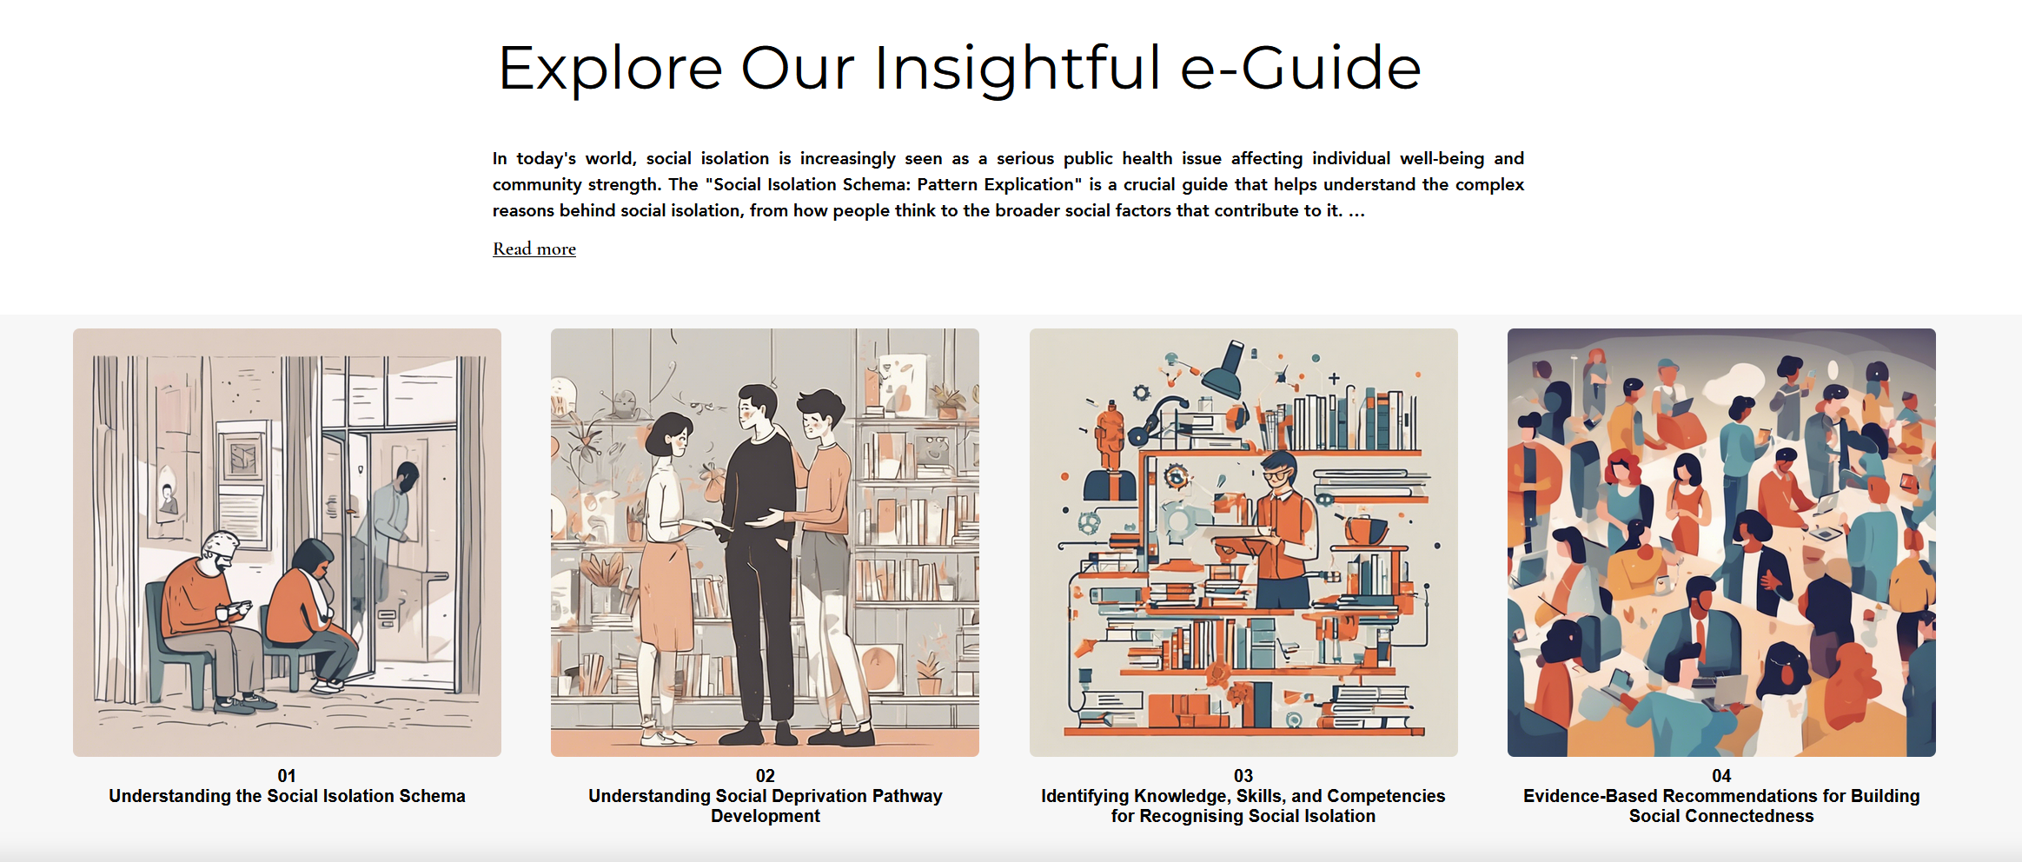
Accessibility & Format
Easy to navigate and use
Aranged in easy to follow chapters
Each chapter is easy to navigate and read
Allows quick navigation between topics and concepts
Moving between chapters, topics and concepts presented is quick and easy

Slide 12
Understanding the Social Isolation Schema
Chapter 1 From the Digital Guide: Understanding the Schema
CARE: Social Death Awareness Initiative
Funded by the European Union. Views and opinions expressed are however those of the author(s) only and do not necessarily reflect those of the European Union or Education Development Agency Republic of Latvia (VIAA). Neither the European Union nor the granting authority VIAA can be held responsible for them. Project N°: 2023-2-LV01-KA210-ADU-000176412

Slide 13
Purpose of Chapter 1
This chapter explores the Social Isolation Schema, focusing on its formation, characteristics, and effects on thoughts, perceptions, and behaviors. Schemas are cognitive frameworks that significantly guide our actions and interactions. By recognizing and addressing this schema, individuals can change their behaviors, and improve their relationships.
Objective: to clarify what the Social Isolation Schema is, explaining how it forms and how it impacts thoughts, perceptions, and behaviors.

Slide 14
What is the Social Isolation Schema?
A pattern of thinking and perception that creates a constant feeling that a person is 'different' or does not belong
Can persist despite active social lives—inner loneliness remains
Often rooted in early maladaptive schemas that drive perception, emotions, and behavior
core beliefs
emotions
behaviour
Sources: Young et al. (2003); Sfeir et al. (2025); Bay Area Cognitive Behavioral Therapy Center (2025).

Slide 15
Key symptoms: emotional
Persistent feelings of loneliness, sadness, or emptiness
Hopelessness or loss of motivation to connect with others
Hypersensitivity to rejection or others’ reactions
Strong self-criticism, sometimes leading to anger or depression
Emotional pain reinforced by anxiety and self-consciousness, creating a vicious cycle
Sources: Young et al. (2003); Sfeir et al. (2025); Bay Area Cognitive Behavioral Therapy Center (2025).

Slide 16
Key symptoms: behavioral
Avoiding social events and preferring solitude
Low participation in group or community activities
Changing routines to minimize social contact
Masking isolation by appearing friendly or busy, driven by fear of rejection
Loss of interest in previously enjoyable activities
Neglecting self-care due to emotional exhaustion
Sources: Young et al. (2003); Sfeir et al. (2025); Bay Area Cognitive Behavioral Therapy Center (2025).

Slide 17
Key symptoms: cognitive
Pretending to fit in, masking their true selves from the belief that their authentic self is "unusual" or facing rejection, which reinforces a strong inner critic
Preoccupation with being seen as a burden
A tendency to distrust others for no tangible reason
These patterns contribute to perpetuating feelings of social isolation and alienation
Sources: Young et al. (2003); Sfeir et al. (2025); Bay Area Cognitive Behavioral Therapy Center (2025).

Slide 18
Schema Theory Foundations
Beck → cognition drives emotion & behaviour; Young → 18 early maladaptive schemas
Five essential emotional needs that all humans share:
  Forming safe and secure connections with others
  Having independence, capability, and a clear sense of self
  Being free to express genuine needs and emotions
  Enjoying spontaneity and play
  Understanding realistic boundaries and self-control
If these needs are not met in childhood, distorted thinking patterns develop
These patterns are harmful emotional and thinking habits that start in childhood and repeat throughout life
Sources: Beck (1967); Erikson (1950); Elliott & Lassen (1997); Young (1990, 1999, 2003); Sfeir et al. (2025).

Slide 19
How Maladaptive Schemas Form
Result of childhood and early adolescence experiences (e.g. rejection, neglect, overprotection)
Traumatic events and experiences, temperament, and identification with significant people also have an impact
Thinking patterns are influenced not only by family, but also by friends, school, and community
Maladaptive Schemas function like filters that distort perception of social interactions
These patterns can be triggered in adulthood by events that remind us of these childhood traumas, causing intense emotions such as sadness, shame, fear, or anger
Sources: Beck (1967); Young (1999, 2003); Ahmadpanah et al. (2017); Bär et al. (2023); Sfeir et al. (2025).
Notes:
Research shows these schemas are important in issues like addiction and anxiety. Young's schema therapy addresses deep and chronic psychological issues by organizing 18 early maladaptive schemas into five groups.

Slide 20
Ostracism & exclusion
Ostracism means being ignored, excluded, or rejected by others — a deeply painful social experience
Threatens four basic psychological needs:
Belonging, Control, Self-esteem, Meaningful existence
Short-term ostracism causes immediate emotional pain and distress
Chronic ostracism leads to depression, helplessness, and feelings of worthlessness
People respond in different ways:
Prosocial (trying to please), Antisocial (anger/aggression), or Withdrawal (isolation)
Sources: Williams (2007, 2009); Eisenberger et al. (2003); Rudert & Greifeneder (2016); Williams & Nida (2022); Chen et al. (2025); Kip et al. (2025); Steele et al. (2014).

Slide 21
Social Isolation vs Social Death
Social Isolation → lack of meaningful social connections and interactions; may lead to loneliness, depression, and poor health
Social Death → a state where a person loses social identity, roles, and connection due to exclusion, neglect, illness, ageing, or being pushed aside by society
Both states threaten belonging, identity, and dignity, but isolation can often be reversed through reconnection and support
Addressing both:
  – Rebuild social identity (for social death)
  – Strengthen social networks (for isolation)
  Introversion is not isolation — it’s a personality trait involving a preference for solitude without emotional distress
Sources: Cain (2012); Cacioppo, et al (2018); Kralova (2015)
Notes:
Introversion is not isolation — it’s a personality trait involving a preference for solitude without emotional distress.

Slide 22
Signs of Social Isolation at Work
Declining performance and productivity – noticeable drop in work quality, more errors, or missed deadlines
Loss of engagement – reduced participation in meetings, decisions, or learning opportunities
Withdrawal from social interaction – avoiding teamwork, skipping social events, or preferring to work alone
Changes in routine or behavior – arriving late, leaving early, or showing reduced motivation
Negative mood and physical strain – irritability, pessimism, fatigue, or recurring health complaints
Sources: Jenkins (n.d.); Cacioppo & Cacioppo (2018); Healthline (2023); National Institute on Aging (2023).

Slide 23
Key Takeaways
Being ignored or excluded is painful — it threatens belonging, control, and self-esteem
Early recognition prevents harm — awareness helps break patterns of disconnection
Recognize schema - driven thoughts and how they shape emotions and behaviour
Take small social steps: build safe relationships, join community or work activities
Therapy and support can help reshape beliefs and restore confidence
Connection and empathy — from educators, employers, and peers — are the keys to rebuilding belonging

Slide 24
Understanding Social Deprivation Pathway Development
Chapter 2 From the Digital Guide: Understanding the Schema
CARE: Social Death Awareness Initiative
Funded by the European Union. Views and opinions expressed are however those of the author(s) only and do not necessarily reflect those of the European Union or Education Development Agency Republic of Latvia (VIAA). Neither the European Union nor the granting authority VIAA can be held responsible for them. Project N°: 2023-2-LV01-KA210-ADU-000176412

Slide 25
In this chapter we explore:
How isolation and deprivation influence behavior and mental health.
How different factors can lead to social deprivation.
Theoretical Frameworks: Attachment theory, maladaptive schemas.

Slide 26
The Importance of Attachment in Human Development
Based on the attachment theory (Bowlby, Ainsworth):
Human development is relational, not purely individual.
Attachment bond: A strong emotional connection between an infant and their primary caregiver.
Importance of Attachment Quality: Central for personality development, behavioral organization, and formation of close interpersonal relationships.
Through a secure attachment, infants gain a safe base to:
  Explore the world around them.
  Learn emotional regulation through co-regulation with the caregiver.

Slide 27
The Importance of Attachment in Human Development
Early Maladaptive Schemas (EMS)
environment fails to meet basic emotional needs → dysfunctional patterns in self & others (Young).
influenced by temperament, personality traits, and cultural factors (Belsky et al, 2007).
most schemas develop in childhood and can be triggered in adulthood under specific conditions.

Slide 28
Exploring the Pathways of Social Isolation Development
EMS: Emotional Deprivation& Social Isolation
Emotional Deprivation Schema: Often forms in childhood due to unmet emotional needs → later difficulties in expressing emotions and forming relationships.
Social Isolation Schema: Develops when caregivers fail to meet emotional needs or when the child feels different or excluded.
Contributing Factors:
Personal circumstances, Social norms & cultural influences, family dynamics.
These factors can make it challenging to establish meaningful connections later in life

Slide 29
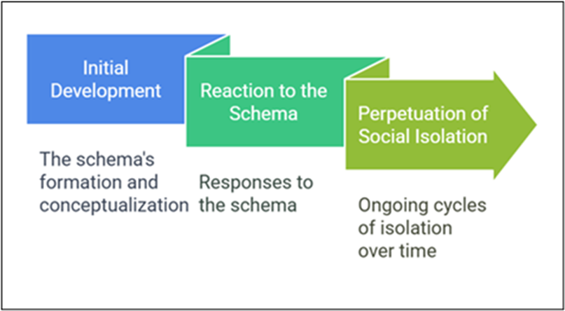
Exploring the Pathways of Social Isolation Development
The Cycle of the Social Isolation Schema
The schema consists of three main phases that explain how it develops and persists over time

Slide 30
Exploring the Pathways of Social Isolation Development
Phases of the Social Isolation Schema
Phase 1 – Initial Development: Triggered by negative experiences such as:
  Discrimination: Feeling different due to factors like ethnicity, religion, or socioeconomic status
  Relocation: Frequent moves during childhood
  Injustice: Unequal or unfair treatment
  Trauma: Experiences of bullying or abuse
Phase 2 – Coping Responses: Individuals may:
  Surrender: abandon aspects of their identity
  Avoid social situations
  Overcompensate by becoming overly social, yet still feel unsafe
Phase 3 – Consolidation:
  Belief that they will always be excluded → Vicious Cycle of Social Isolation

Slide 31
Exploring the Pathways of Social Isolation Development
Case Study: Mark – Workplace Social Isolation
Description: Dedicated law firm employee, feels neglected and excluded despite hard work.
Exclusion Factors: Only openly gay team member; faces subtle hints and homophobic comments → isolation & anxiety.
Impact: Pressure leads to mistakes, reduced performance, and physical symptoms.
Response: New HR director aims to improve climate and inclusivity, but Mark avoids related sessions.
Schema Consolidation: Ongoing disconnection leaves him emotionally drained and uncertain about his future

Slide 32
Exploring the Pathways of Social Isolation Development
Workplace Social Isolation
Research Insights
Such phenomena are linked to similarities between family and work environments (e.g., power dynamics with parents or siblings).
Recognizing schemas highlights individual vulnerabilities and helps identify unhelpful behavioral patterns → supports personal growth & understanding.
Fostering a culture of open communication, support, and continuous learning promotes a healthier and more productive workplace.

Slide 33
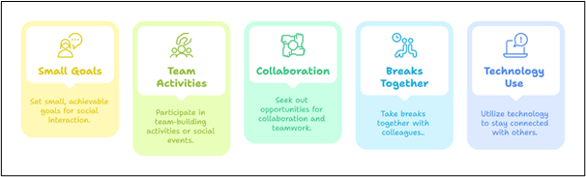
Exploring the Pathways of Social Isolation Development
Practical Strategies for Employees & Organizations
Social Interaction Practices

Slide 34
Key Takeaways
Human connection is fundamental: secure attachments in early life build emotional stability and resilience.
Unmet emotional needs in childhood can form Early Maladaptive Schemas, shaping how individuals view themselves and others.
Social deprivation pathways emerge through a mix of factors:
  Caregiver neglect or emotional unavailability
  Personal differences (e.g., identity, ability, or appearance)
  Societal and cultural exclusion or discrimination
The Cycle of Social Isolation includes:
  Early negative experiences
  Coping responses (avoidance, surrender, or overcompensation)
  Reinforced beliefs of not belonging
Workplace and community awareness can break this cycle through empathy, inclusion, and emotional intelligence.

Slide 35
Identifying Knowledge, Skills, and Competencies for Recognising Social Isolation
Chapter 3 From the Digital Guide: Understanding the Schema
CARE: Social Death Awareness Initiative
Funded by the European Union. Views and opinions expressed are however those of the author(s) only and do not necessarily reflect those of the European Union or Education Development Agency Republic of Latvia (VIAA). Neither the European Union nor the granting authority VIAA can be held responsible for them. Project N°: 2023-2-LV01-KA210-ADU-000176412

Slide 36
Purpose of Chapter 3
Moving from Theory to Practice
This chapter provides a practical toolkit to move from understanding social isolation to effectively addressing it.
Objective: To equip educators, employers, and professionals with the essential knowledge, skills, and competences to recognise signs of social isolation and take meaningful action to foster inclusive environments.

Slide 37
The Foundation: Essential Knowledge
Going Beyond Basic Empathy
Addressing isolation requires a solid, interdisciplinary knowledge base.
Key Knowledge Areas:
Psychological & Neuroscientific Insights: Understanding that social pain mirrors physical pain in the brain.
Recognising Common Indicators: Identifying behavioural, emotional, and physical signs across different settings.
Structural & Systemic Barriers: Seeing how poverty, discrimination, and policy failures contribute to isolation.
Cultural & Social Awareness: Knowing how isolation manifests differently across cultures.
Organisational Policies: Learning how inclusive workplace and institutional policies can prevent isolation.

Slide 38
The Bridge to Action: Core Skills
Applying Awareness in Real-Life Situations
Skills form the bridge between knowing what to do and actually doing it.
1. Cognitive Skills:
Critical Thinking: Analyzing root causes of isolation.
Awareness & Recognition: Spotting subtle signs of withdrawal or disengagement.
2. Emotional Skills:
Empathy & Compassion: Listening without judgment.
Emotional Regulation: Managing personal bias and fatigue.
3. Behavioral Skills:
Effective Communication & Active Listening: Building trust and making people feel heard.
Advocacy & Allyship: Challenging exclusionary behaviors and policies.

Slide 39
Integrating Abilities: Key Competences
The Ability to Take Effective Action
Competence is the proven ability to use knowledge and skills to achieve a goal.
Key Competences for Professionals:
Cultural & Social Awareness: Adapting interventions to different contexts.
Interdisciplinary Knowledge Application: Using insights from sociology, psychology, and public health.
Resilience & Adaptability: Persisting through slow progress and resistance.
Ethical & Inclusive Leadership: Championing fairness and equity in policies.
Policy & Structural Understanding: Advocating for systemic changes that foster inclusion.

Slide 40
How to Develop These Competences
Practical Pathways to Growth
Competences are built through active engagement and reflection.
Volunteering & Community Engagement: Gaining real-world experience.
Shadowing & Mentorship: Learning from experienced professionals.
Networking & Knowledge Exchange: Sharing best practices with peers.
Advocacy & Policy Involvement: Influencing systemic change.
Leading Initiatives: Managing projects that promote social inclusion.

Slide 41
The Power of Experience
Learning by Doing
First-hand experience is crucial for deep understanding and effective action.
For Personal Competence Development:
Engage directly with marginalized groups.
Facilitate inclusive discussions on diversity and belonging.
Design and implement support programs (e.g. peer mentorship).
For Creating Inclusive Environments:
Educators: Use role-playing, case studies, and safe classrooms.
Employers: Implement wellness programs, inclusion training, and flexible work arrangements.

Slide 42
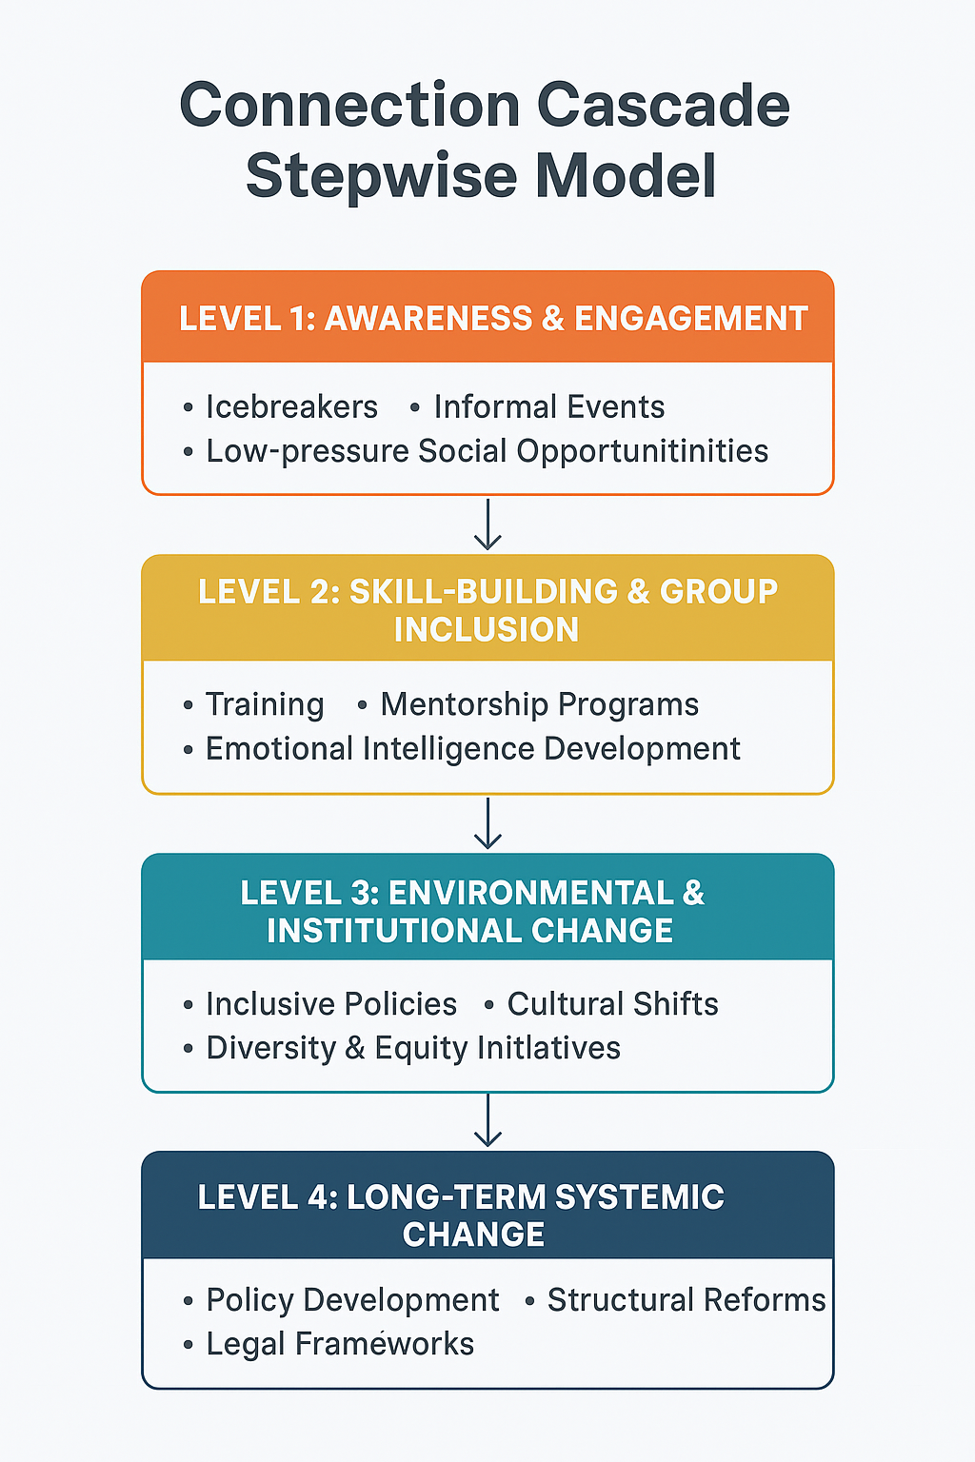
Structured Interventions for Organisations
A Multi-Layered Strategy
Effective action requires structured models tailored to different levels.
The Connection Cascade Model:
Awareness & Engagement: Icebreaker activities, informal networking.
Skill-Building: Training on emotional intelligence and active listening.
Institutional Change: Embedding DEI (Diversity, Equity, Inclusion) in policies.
Systemic Change: Implementing national policies for social well-being.

Slide 43
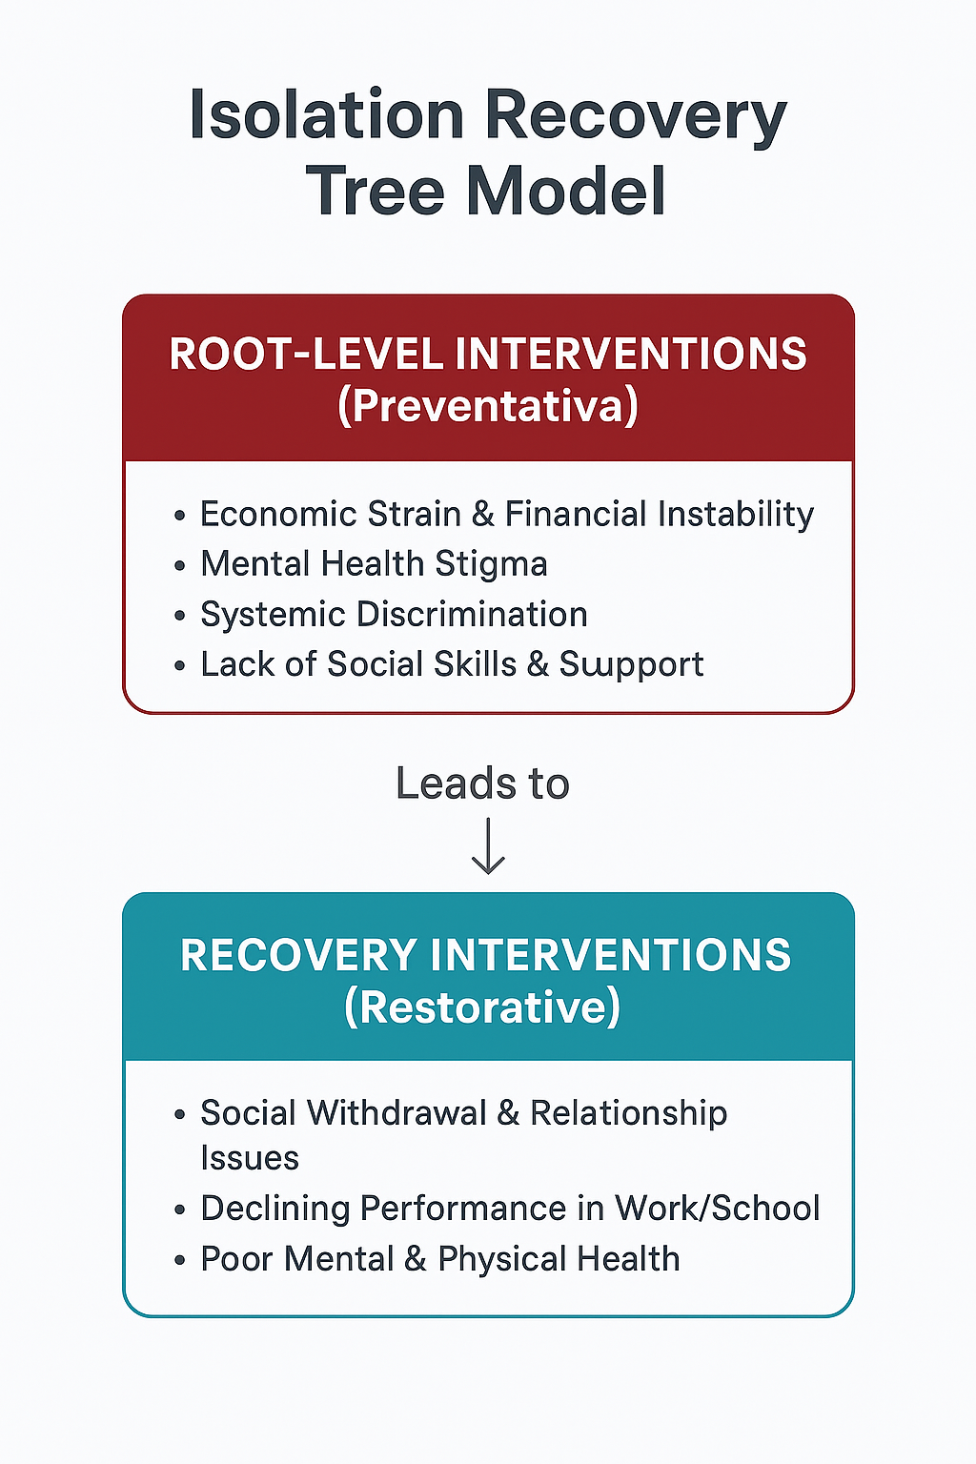
The Isolation Recovery Tree Model
A Dual-Focus Approach
This model addresses both the root causes and the visible symptoms of social isolation for a holistic intervention strategy.
Root-Level Interventions (Preventative):
  Target the underlying, systemic causes hidden beneath the surface.
  Examples: Financial wellness programs, anti-stigma campaigns, inclusive hiring policies, social skills training.
Recovery-Level Interventions (Restorative):
  Address the immediate, visible consequences and symptoms.
  Examples: Peer support groups, counseling services, reintegration projects, one-on-one mentoring.
By combining root-level prevention with recovery-level support, this model ensures a sustainable approach that helps those affected while working to prevent isolation from taking hold in the first place.

Slide 44
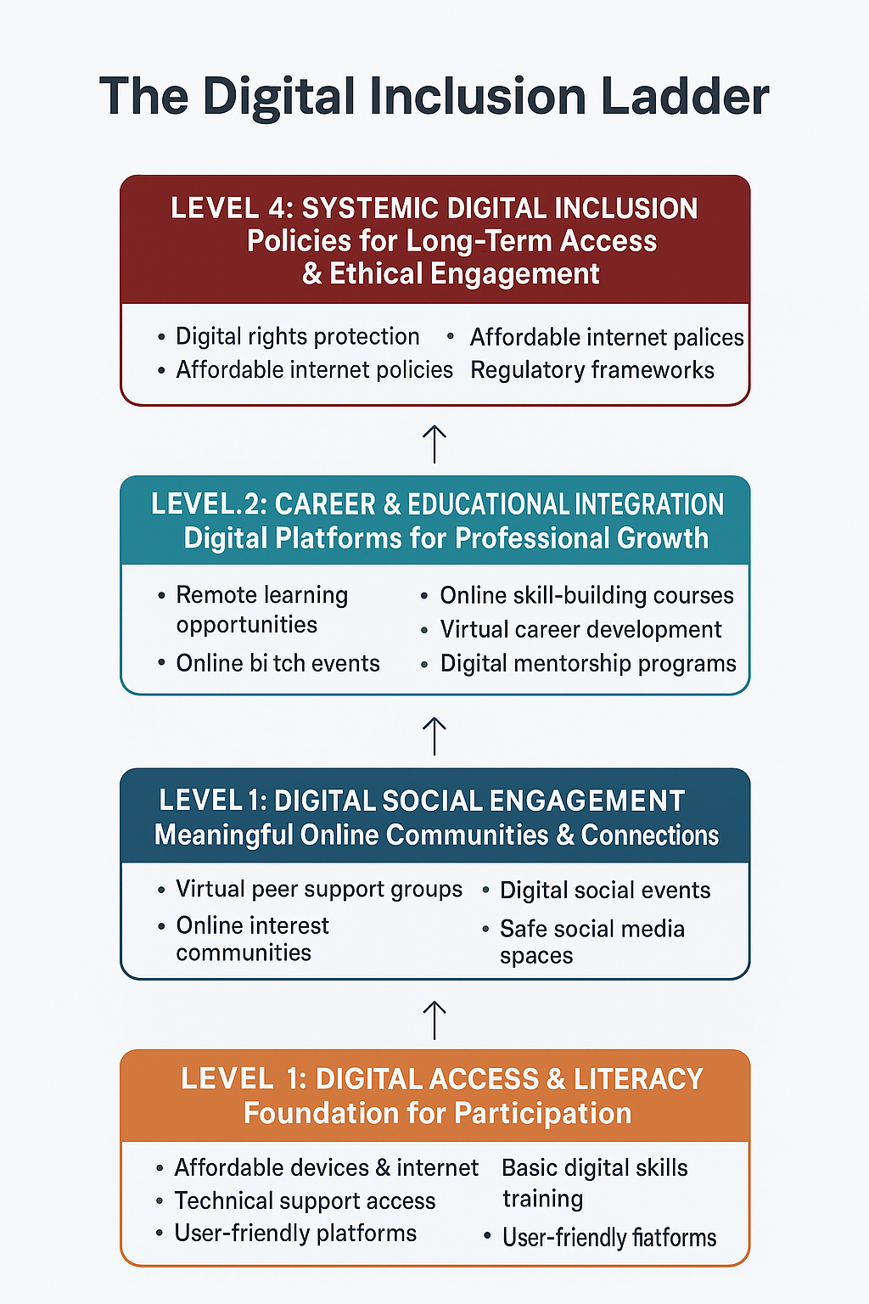
The Digital Inclusion Ladder
Using Technology to Connect, Not Isolate
A model to ensure digital tools bridge social gaps.
Progressive Stages:
Digital Access & Literacy: Providing devices and skills training.
Digital Social Engagement: Creating meaningful online communities.
Career & Educational Integration: Using platforms for remote learning and development.
Systemic Digital Inclusion: Establishing policies for long-term, ethical access.

Slide 45
Key Takeaways
Your Action Plan
Knowledge is the base: Understand the complex roots and signs of isolation.
Skills are the bridge: Practice cognitive, emotional, and behavioral skills daily.
Competence is the goal: Integrate your abilities to take effective, real-world action.
Experience is the teacher: Seek out and create inclusive interactions and environments.
Use structured models: Implement frameworks like the Connection Cascade for sustainable impact.

Slide 46
Evidence-Based Recommendations for Building Social Connectedness
Chapter 4 From the Digital Guide: Understanding the Schema
Funded by the European Union. Views and opinions expressed are however those of the author(s) only and do not necessarily reflect those of the European Union or State Education Development Agency Republic of Latvia (VIAA). Neither the European Union nor the granting authority VIAA can be held responsible for them. Project N°: 2023-2-LV01-KA210-ADU-000176412

Slide 47
Social Connectedness Recommendations
Branching Scenarios
3 sub-themes
Understanding the Social Isolation Schema – Chapter 1
Understanding Social Deprivation Pathway Development – Chapter 2
Identifying Knowledge, Skills, Competences, and Experiences for Recognizing Social Isolation – Chapter 3
Notes:
Introductory speech: Chapter 4 is known as social connectedness recommendations and it is dedicated for the branching scenarios in order to help readers practice the theoretical foundations learned in Chapters 1 through 3. Under the main theme of social connectedness recommendations, we have 3 subthemes: understanding the social …, understanding social deprivation, and identifying ….associated with the each chapter discussed earlier.
The first subtheme (understanding the social isolation schema) is linked to the first chapter and involves scenarios that focus on the complex interactions that contribute to feelings of exclusion.
The second subtheme (understanding social deprivation pathway development)is linked to the second chapter and involves scenarios that focus on how personal history, emotional needs, and social environments intersect to shape behavior and well-being. – basically aim to practically explore how those can contribute to the development and reinforcement of social isolation.
The third subtheme (identifying knowledge, skills, competences, and experiences for recognizing social isolation) is associated to the chapter 3 and focuses on the specific knowledge, skills, and interpersonal competencies needed to identify and respond to social isolation across diverse settings.

Slide 48

Social Connectedness Recommendations
Fostering Public Speaking Confidence in Socially Isolated Individuals
Introduction
As an adult educator aiming to improve your students’ public speaking skills, you assign each of them a presentation topic. During the topic allocation, you notice that Elizabeth becomes anxious and appears hesitant to participate. On several occasions, you have also heard her express discomfort with her body image, as she perceives herself to be ''overweight.’’
Decision Point:
Elizabeth has not confirmed her presentation date. How can you encourage her to take initiative?
Choice 1: Offer Elizabeth alternative presentation formats—e.g., a pre-recorded video.
Choice 2: Assign a presentation date to Elizabeth yourself, giving her a clear deadline.
Choice 3:
Choose not to address Elizabeth’s hesitation and proceed without following up on the date.
Least effective: Elizabeth feels unnoticed and pressured, which increases her anxiety. Elizabeth’s isolation is reinforced.
Notes:
Introductory speech: Now we will be discussing few scenarios in an interactive manner. In line with this, you will be introduced to the practical, real-life contexts in which individuals can recognize and respond to the dynamics of social isolation. Note that, the scenarios will demonstrate both ineffective and effective strategies for fostering inclusion, revealing the consequences of various actions taken in response to social isolation. Within these scenarios, you will be asked to act as an adult educator or adult learner. Now let’s start with the first scenario in which you need to imagine yourself as an adult educator. This scenario is about fostering public speaking confidence in socially isolated individuals.
Instructions: Presenter reads the scenario and provides some time for the audience – then introduce the choices – ask them the least effective one (probably majority will choose the choice 3) – explain why it is ineffective by reading the conclusion and feedback below.
Conclusion & Feedback:
Ignoring the problem causes Elizabeth to face ongoing social isolation and related challenges in every area of her life that involves social interaction.
As an educator, you can make a meaningful difference in reducing the challenges faced by socially isolated individuals by taking supportive and intentional steps.
Then continue with the first 2 choices - ask audience which one they would like to work on first –then click the option selected – it will direct you to the branching scenarios that are in line with the chosen option. (once either of the choices are analyzed – you will need to come back this slide by clicking to the ‘go back to choices’ button in the upcoming slides-then you can continue with the unanalyzed choice)

Slide 49
Social Connectedness Recommendations
Key Learning Points
Go back to choices
Elizabeth feels different from her peers, which further intensifies her anxiety.
Choice 1: Speak directly to Elizabeth and tell her she needs to get help for her body image issues.
Choice 2: Ignore Elizabeth’s concerns and proceed with the class as planned.
Elizabeth feels even more different from her peers and thinks that her body image concerns are highly visible to others.
Elizabeth feels unnoticed and pressured, which increases her anxiety.
Choice 2: Make a public speech and reassure others that it is okay to seek support if they feel they need it.
Choice 1: Gently talk with Elizabeth in a supportive setting, acknowledge her feelings and encourage her to consider speaking with a professional
Choice 1: Change the structure of your educational program to make it less interactive in order to reduce discomfort.
Choice 2: Allow Elizabeth practice her presentation with you beforehand.
This approach leads to the issue remaining unresolved and persisting over time.
This may embarrass Elizabeth, as she might feel singled out.
Elizabeth feels understood by you and becomes more willing to overcome the situation.
Elizabeth gains confidence and feels more comfortable during her presentation.
Notes:
Instructions: Choice 1’s results – explain them choosing option 1- Offering Elizabeth alternative presentation formats—e.g., a pre-recorded video will yield Elizabeth to feel different from her peers … and provide the other choices before moving on the result of each choice ask audience’s ideas – once discussion is over – continue with the following options in each case –
At the end – click to open randomly distributed result options (at the bottom of the slide – as you will see 4 option for this slide) – tell audience that you will be playing matching game and start with the first result
ORDER OF MATCHING EXERCISE
First: This approach leads to the issue remaining unresolved and persisting over time – ask them to match this result to the last choices discussed above – take their opinions and click to see the correct match.
The second result is your speech … apply the same method
The third one Elizabeth gains confidence … apply the same method
The fourth one Elizabeth feels understoond …apply the same method
The last click will direct you either to the key learning points (slide 5) or to the scenario (slide 2)– only click to the ‘key learning points’ if you already cover the all other choices. If not, you will need to click on go back to choices button to turn back to the main scenario (slide 2) and choose the one of the unanalyzed choice.

Slide 50
Social Connectedness Recommendations
Go back to choices
Key Learning Points
Elizabeth feels a lack of control, which further increases her anxiety.
Choice 1: Arrange a private conversation with Elizabeth before her presentation date to check in on how she is feeling.
Choice 2: Arrange a private conversation with Elizabeth after her presentation to evaluate her presentation performance.
Elizabeth opens up and shares her concerns with you, offering insights into why she tends to isolate herself from others.
Choice 2: Allow Elizabeth to choose her own topic so that she feels more in control during her presentation.
Choice 1:
Emphasize your understanding and encourage her to start by speaking in small groups.
Creates supportive environment by ensuring that she is not alone, boost Elizabeth's confidence.
Although she lacks control over her body image, this option gives her a sense of control.
Focus solely on her performance-she feels her emotions being negleted.
Notes:
Instructions: Choice 2’s results – explain them choosing option 2- Assigning a presentation date to Elizabeth yourself, giving her a clear deadline will yield Elizabeth to feel lack of control … and provide the other choices before moving on the result of each choice ask audience’s ideas – once discussion is over – continue with the upcoming choices/results
At the end – click to open randomly distributed result options (at the bottom of the slide – as you will see 3 option for this slide) – tell audience that you will be playing matching game and start with the first result
ORDER OF MATCHING EXERCISE
First ask for although she lack control ….
Second ask for creates supportive
Last ask for focus soley on her performance
The last click will direct you either to the key learning points (slide 5) or to the scenario (slide 2)– only click to the ‘key learning points’ if you already cover the all other choices. If not, you will need to click on go back to choices button to turn back to the main scenario (slide 2) and choose the one of the unanalyzed choice.

Slide 51
Key Learning Points – Brainstorming Activity
Personal circumstances-such as physical appearance can contribute to the social isolation, especially in situations that require social interaction, like public speaking.
Changing situational factors may help temporarily, but lasting solutions come from addressing emotional needs with empathy and support.
Non-authoritative approaches and adaptability are essential skills for adult educators when supporting socially isolated individuals.
Notes:
Instructions: Ask audience what they learnt from the given scenario – ask them to link the scenarios to the points mentioned before the branching scenarios.

Slide 52
Social Connectedness Recommendations
Recognizing and Replacing Unhealthy Coping Mechanisms with Healthier Ones
Introduction
You are John, an employee at a private company. Due to childhood trauma, you experience social isolation and cope by overcompensating—appearing confident and forcing social interaction. One day, colleagues invite you out after work. You feel overwhelmed but consider going, mainly to maintain the appearance of being socially engaged.
Decision Point:
How would you respond?
Choice 1:
Find an excuse to avoid going.
Choice 2: Go to the event but say that you became sick and leave early.
Choice 3:
Go anyway, even if you feel overwhelmed.
Notes:
Introductory speech: Now let’s continue with the second scenario in which you need to imagine yourself as an adult learner. This scenario is about recognizing and replacing unhealthy coping mechanisms with healthier ones
Instructions: Presenter reads the scenario and provides some time for the audience – then introduce the choices – ask them with which choice they would prefer to continue…. Based on their choice – click on it and continue with the preferred choice. Similarly to the first scenario – clicked choice will direct you to the corresponding branching scenarios.
*Again once either of the choices are analyzed – you will need to come click ‘go back to choices’ button in the upcoming slides to back to this slide to click the unanalyzed choice)

Slide 53
Social Connectedness Recommendations
Go back to choices
Key Learning Points
Brings only temporary relief as it avoids addressing the roots of the problem.
Choice 1: Politely decline but show interest in joining next time.
Choice 2: Apply compensation for the next time - Join no matter how you feel.
Respects your boundaries and keeps future interactions open.
Choice 2:
Wait for the situation to improve naturally.
Choice 1:
Talk privately with a trusted colleague or supervisor about your feelings.
Delays progress and avoids taking action.
Social isolation is reinforced.
You feel supported, understood and more comfortable.
Notes:
Instructions: Choice 1’s results – explain them choosing option 1- finding excuse to avoid going will bring only temporary relief… and provide the other choices before moving on the result of each choice ask audience’s ideas – once discussion is over – continue with the upcoming choices and results–
Same logic as the first scenario* At the end – click to open randomly distributed result options (at the bottom of the slide – as you will see 3 option for this slide) – tell audience that you will be playing matching game and start with the first result
The last click will direct you either to the key learning points (slide 10) or to the scenario (slide 6)– only click to the ‘key learning points’ if you already cover the all other choices. If not, you will need to click on go back to choices button to turn back to the main scenario (slide 6) and choose the one of the unanalyzed choice.

Slide 54
Social Connectedness Recommendations
Go back to choices
Key Learning Points
Allows you to avoid full participation but still delays addressing the issue.
Choice 1: Try to set your boundaries and say no next time.
Choice 2: Come up with a better excuse next time to avoid similar situations.
Reduces overcompensation and increases self-awareness
Choice 2:
Reflect on your feelings and write them down to further support self-awareness.
Choice 1: Talk with your supervisor, ask for support, and set small goals.
Progress is evident but slower, as it lacks a social component.
Supports well-being and inclusion by involving others.
Social isolation is reinforced.
Notes:
Instructions: Choice 2’s results – explain them choosing option 2- Going to the event but say that you became sick and leave early will yield John to avoid full participation but still does not address the main issue… and provide the other choices before moving on the result of each choice ask audience’s ideas – once discussion is over – continue with the following options in each case –
Same logic as the first scenario* At the end – click to open randomly distributed result options (at the bottom of the slide – as you will see 3 option for this slide) – tell audience that you will be playing matching game and start with the first result
The last click will direct you either to the key learning points (slide 10) or to the scenario (slide 6)– only click to the ‘key learning points’ if you already cover the all other choices. If not, you will need to click on go back to choices button to turn back to the main scenario (slide 6) and choose the one of the unanalyzed choice.

Slide 55
Social Connectedness Recommendations
Key Learning Points
Go back to choices
Increases anxiety and reinforces unhealthy coping strategies (overcompensation).
Choice 1: Stop overcompensating and choose avoidance strategy.
Choice 2: Share your insecurities with HR and ask for support.
Reinforce a different unhealthy strategy.
Offers guidance & supports-reduces overcompensation.
Conclusion & Feedback:
Overcompensation, for instance, forcing yourself to attend events, reinforces unhealthy coping. Replacing one unhealthy strategy with another is not the solution (i.e., avoidance/ignorance of emotions).
Opening up to a knowledgeable and trusted person can help you build healthier ways to manage social challenges.
Notes:
Instructions: Choice 3’s results – explain them choosing option 3- Going anyway, even if you feel overwhelmed will increase John’s anxiety and reinforce unhealty coping strategies … and provide the other choices
Tell them the effectiveness of each choice is more straightforward in this choice and explain them the overcompensation process by relying on the conclusion and feedback part written on the slide –
Questions to engage participants more:
1-ask whether they know someone who apply overcompensation throughout their everyday interactions with others,
2- based on our discussions over scenarios, what can they do to overcome this?
The last click will direct you either to the key learning points (slide 10) or to the scenario (slide 6)– only click to the ‘key learning points’ if you already cover the all other choices. If not, you will need to click on go back to choices button to turn back to the main scenario (slide 6) and choose the one of the unanalyzed choice.

Slide 56
Key Learning Points – Brainstorming Activity
Personal circumstances, such as childhood trauma, can contribute to social isolation.
Self-awareness is the first step in recognizing unhealthy coping, but social support is essential for meaningful progress and lasting inclusion.
Overcompensation is a common coping strategy used by socially isolated individuals to mask their discomfort in social situations.
Notes:
Instructions: Ask audience what they learnt from the given scenario – ask them to link the scenarios to the points mentioned before the branching scenarios.
Highlight the importance of saying NO as a healthy and valid step in overcoming overcompensation
The importance of social dimension should be emphasized too.

Slide 57
Thank You for your attention!

